Slide 1
Project “Edible Me”
__ Midterm progress report

Slide 2
Today's topic
Introduction of background
Design processes
Implementation processes
Learned experiences
Summary

Slide 3
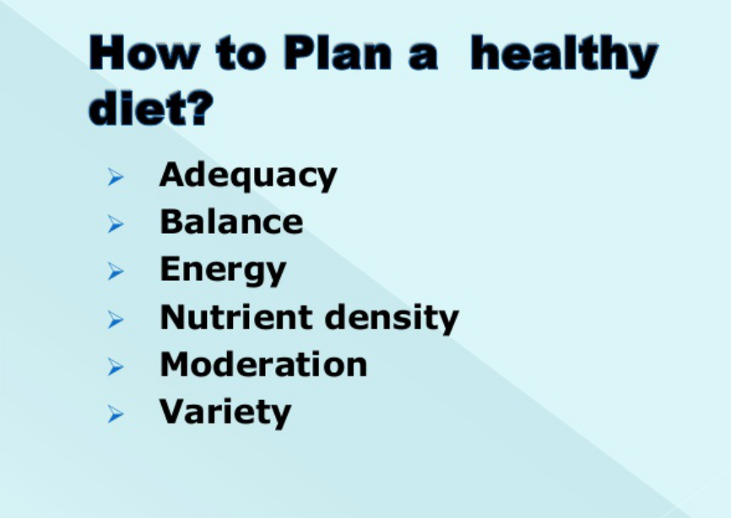
Introduction of background
Dietary planning: Planning diets according to certain factors.
Related also to person's flavor, status, current health condtions, processes of food and interactions between food.
Could be time consuming.
Is basically a decision-making process.
Information from Dr. Toby Mechelena, Course BIO 3200, Dietary planning, in Winter 2016

Slide 4
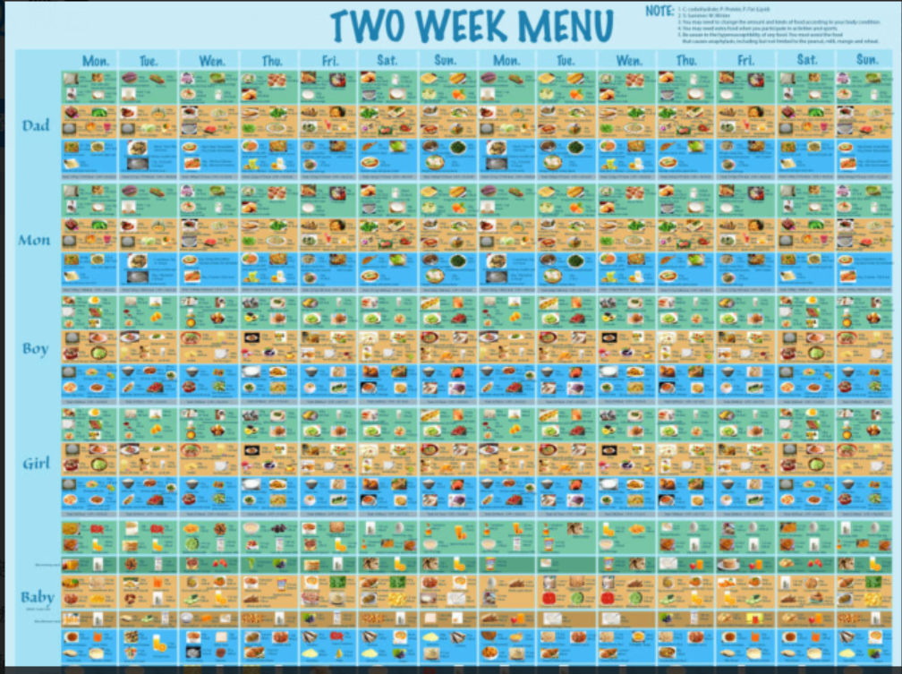
Freddy W., Jie W and Sam Y. Dietary planning work, in Winter 2016

Slide 5
Today's topic
Introduction of background
Design processes
Implementation processes
Learned experiences
Summary

Slide 6
Phase I: Brain Storming
Factors (Entites)
Interactions (Relationships)
Functions
Implementation Details

Slide 7
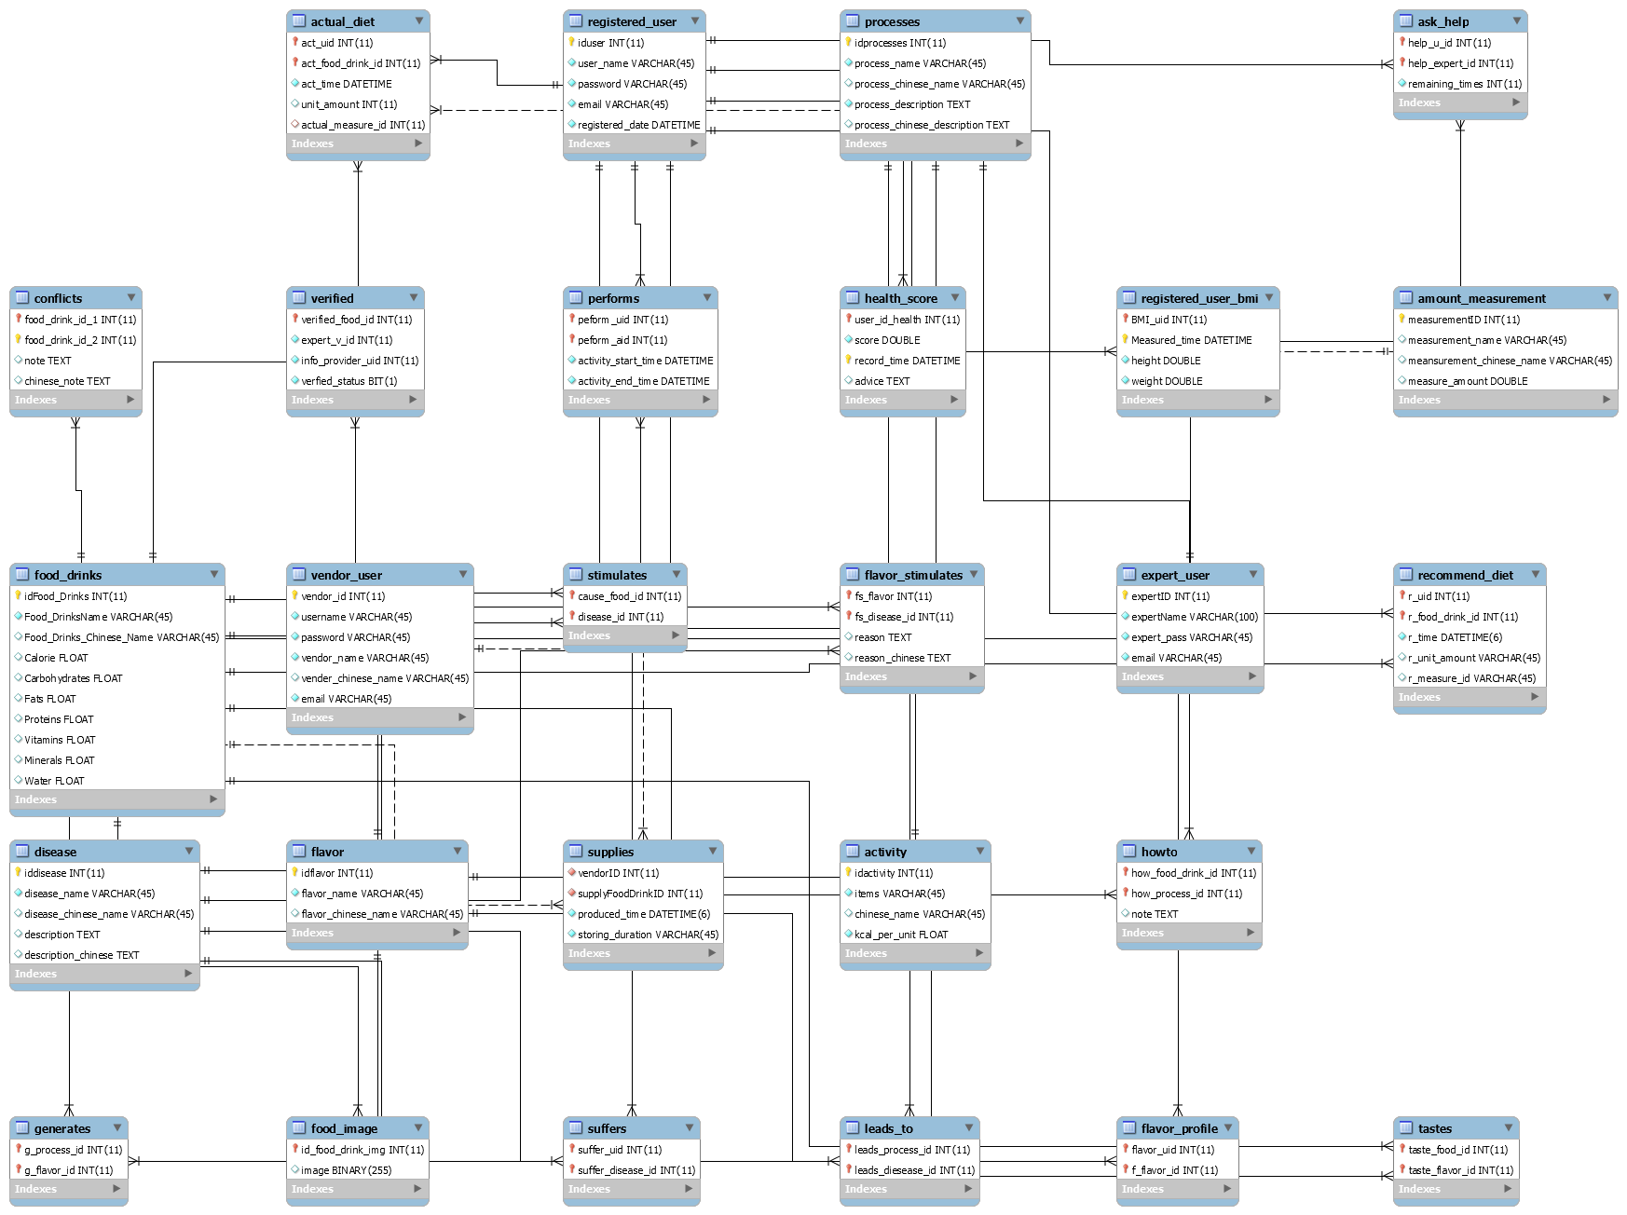
Phase II: Database Design
Consider factors of entities and relationships

Slide 8
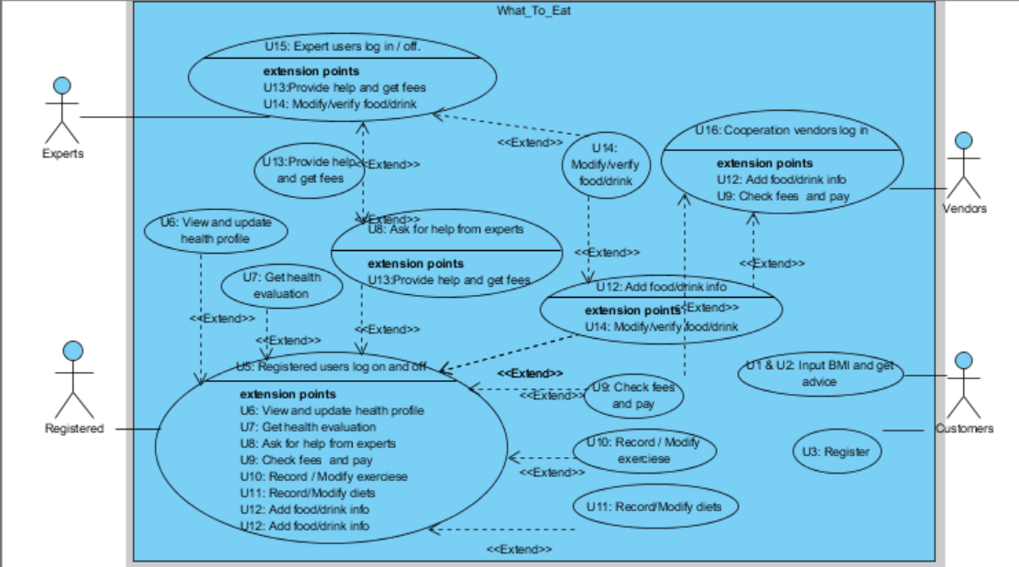
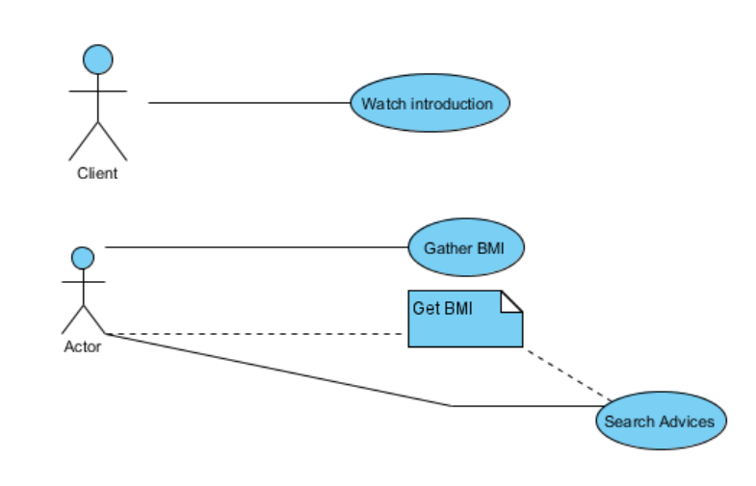
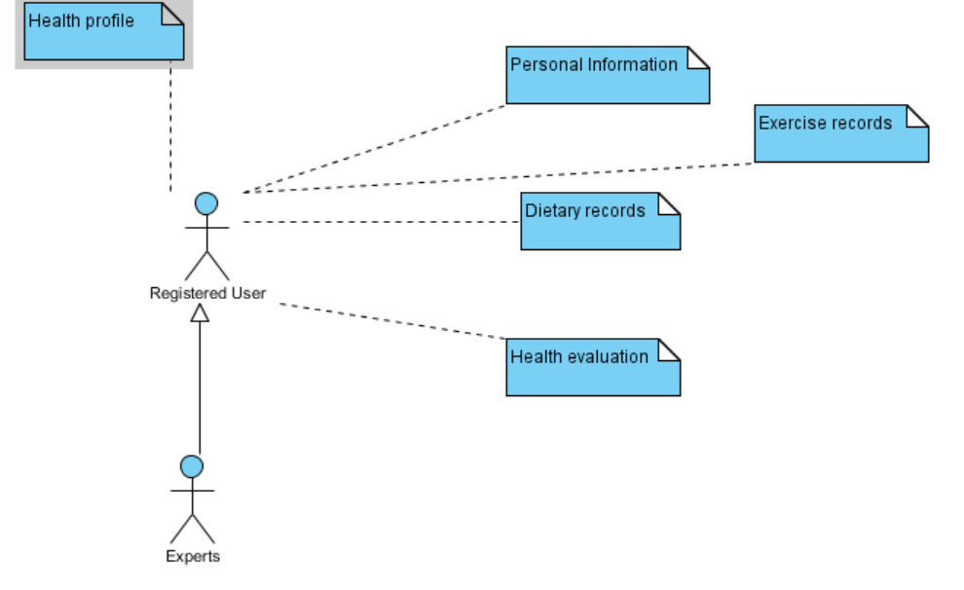
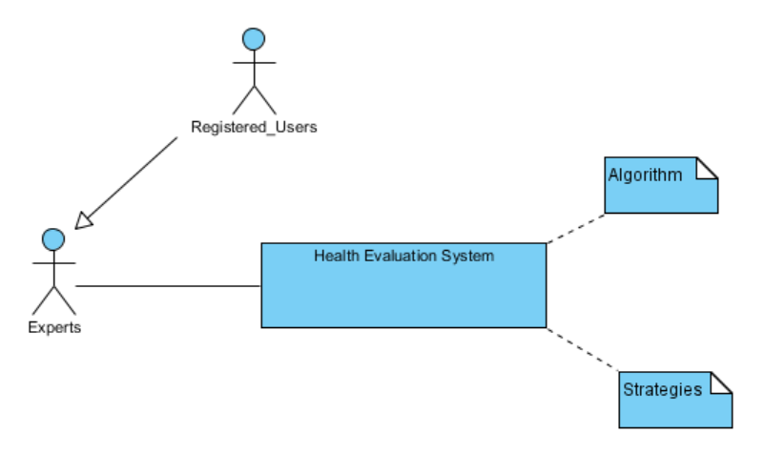
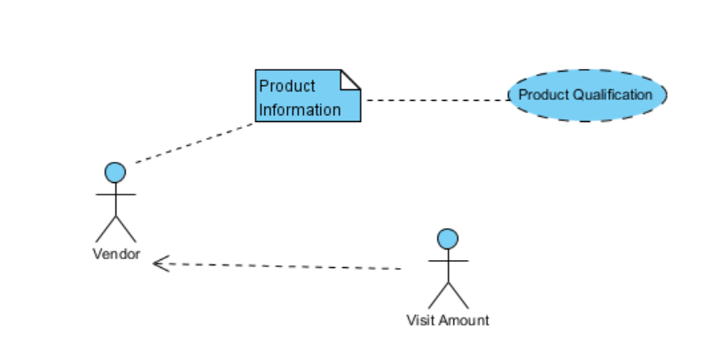
Phase III: Class Diagram
Consider the functions

Slide 9
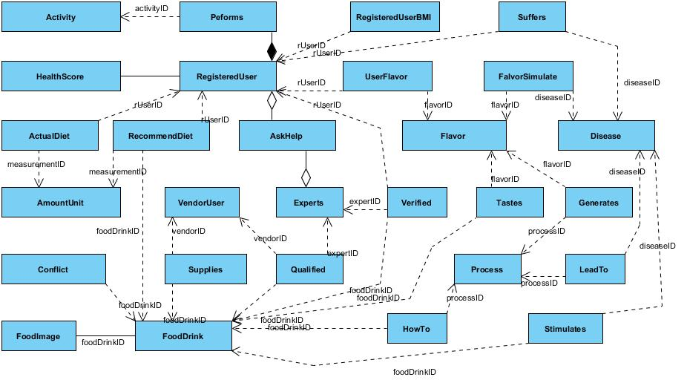
Phase IV: Implementation Details
How to implement the big E-R picture?

Slide 10
Today's topic
Introduction of background
Design processes
Implementation processes
Learned experiences
Summary

Slide 11
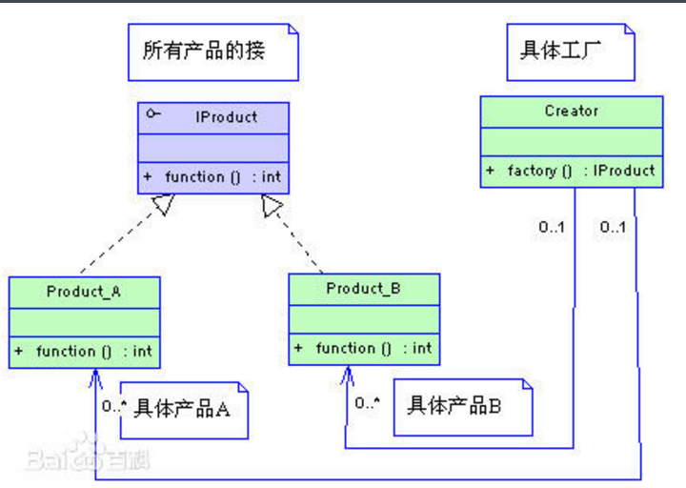
“Factory Mode”
The Product is not directly calling the creator
Frame does not directly calling the entites, but its APIs.
Image of Factory Mode, URL: https://baike.baidu.com/pic/, used at 12:18, 10th, Apr, 2017

Slide 12
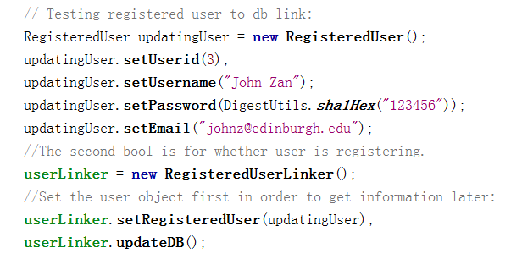
One-way encryption API
Using API org.apache.commons.codec.digest.DigestUtils;
Leave the encryption/ security processes at the program stage.
Access control itself is already a measurement in computer security. (Also might be attacked)

Slide 13
Today's topic
Introduction of background
Design processes
Implementation processes
Experiences learned
Summary

Slide 14
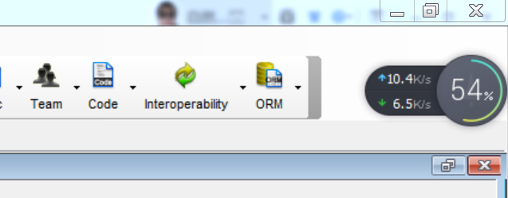
Experiences learned
“New” Tech. (Unfamiliar Tech.)
Scale of the project (Spiral Model)
E-R leads to design
Design leads to implementation
Pic: Interface of Visual Paradigm. Generating code (basic entities) is a quick process, design is more important.

Slide 15
Summary
Introduction of background
Design processes
Implementation processes
Learned experiences
Q & A

Slide 16
Thank you!

